Slide 1


Lead Scoring Case Study
DS C68 Batch
Submitted by:
Gautham M
Harish N
Richa G
Upgrad Assignment

Slide 2








Problem Statement and Objective
-
Solution Methodology
EDA (Visualizations)
Correlation
Model Building
Model Evaluation
Observation & Conclusion
Upgrad Assignment

Slide 3

Problem Statement & Objective
Problem Statement:
X Education sells online courses to industry professionals.
X Education gets a lot of leads, its lead conversion rate is very poor. For example, if, say, they acquire 100 leads in a day, only about 30 of them are converted.
To make this process more efficient, the company wishes to identify the most potential leads, also known as ‘Hot Leads’.
If they successfully identify this set of leads, the lead conversion rate should go up as the sales team will now be focusing more on communicating with the potential leads rather than making calls to everyone.
Objective:
X education wants to know most promising leads. For that they want to build a Model which identifies the hot leads. CEO of X education want to achieve a lead conversion rate of 80%.
Once completed, Deployment of the model for the future use.
Upgrad Assignment

Slide 4
Solution Methodology
Importing data and inspecting the data frame
Data preparation(Data cleaning and data manipulation)
EDA(Univariate data analysis, Bivariate data analysis)
Dummy variable creation
Test-Train split
Feature scaling
Correlations
Model Building (Logistic Regression used ,with statistical evaluation - RFE,VIF and p- values)
Model Evaluation
Making predictions on test set
Upgrad Assignment

Slide 5
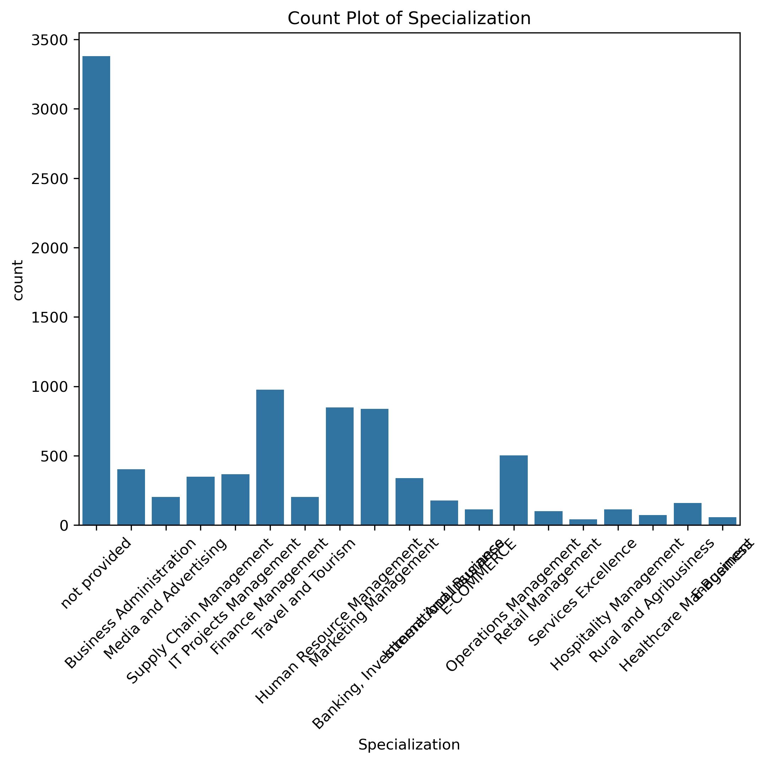
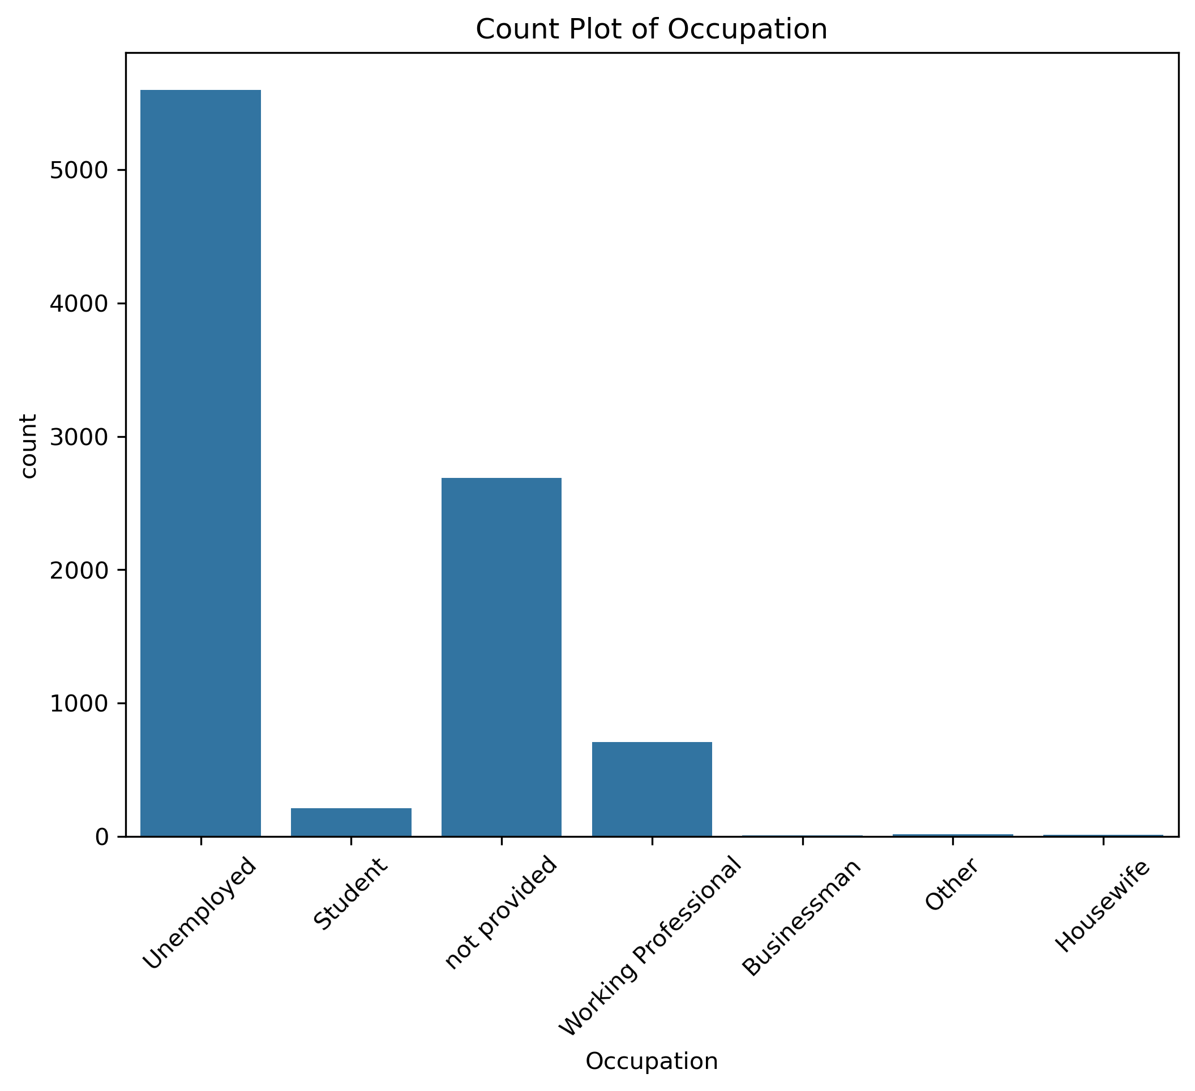
EDA – Variables with “Select” datapoints
Variables like Specialization, Occupation and How did you ear about X education has “Select” as one of the option which is similar to NAN values , Hence they are imputed as “not provided”
Upgrad Assignment

Slide 6
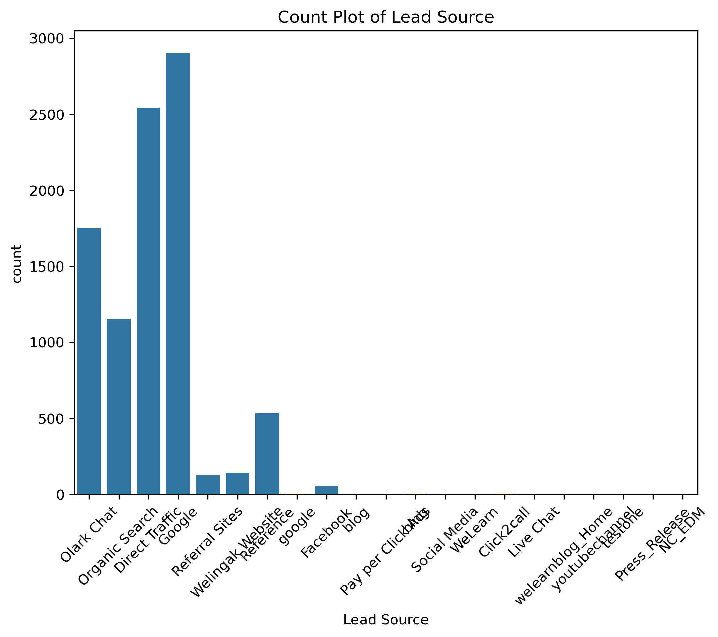
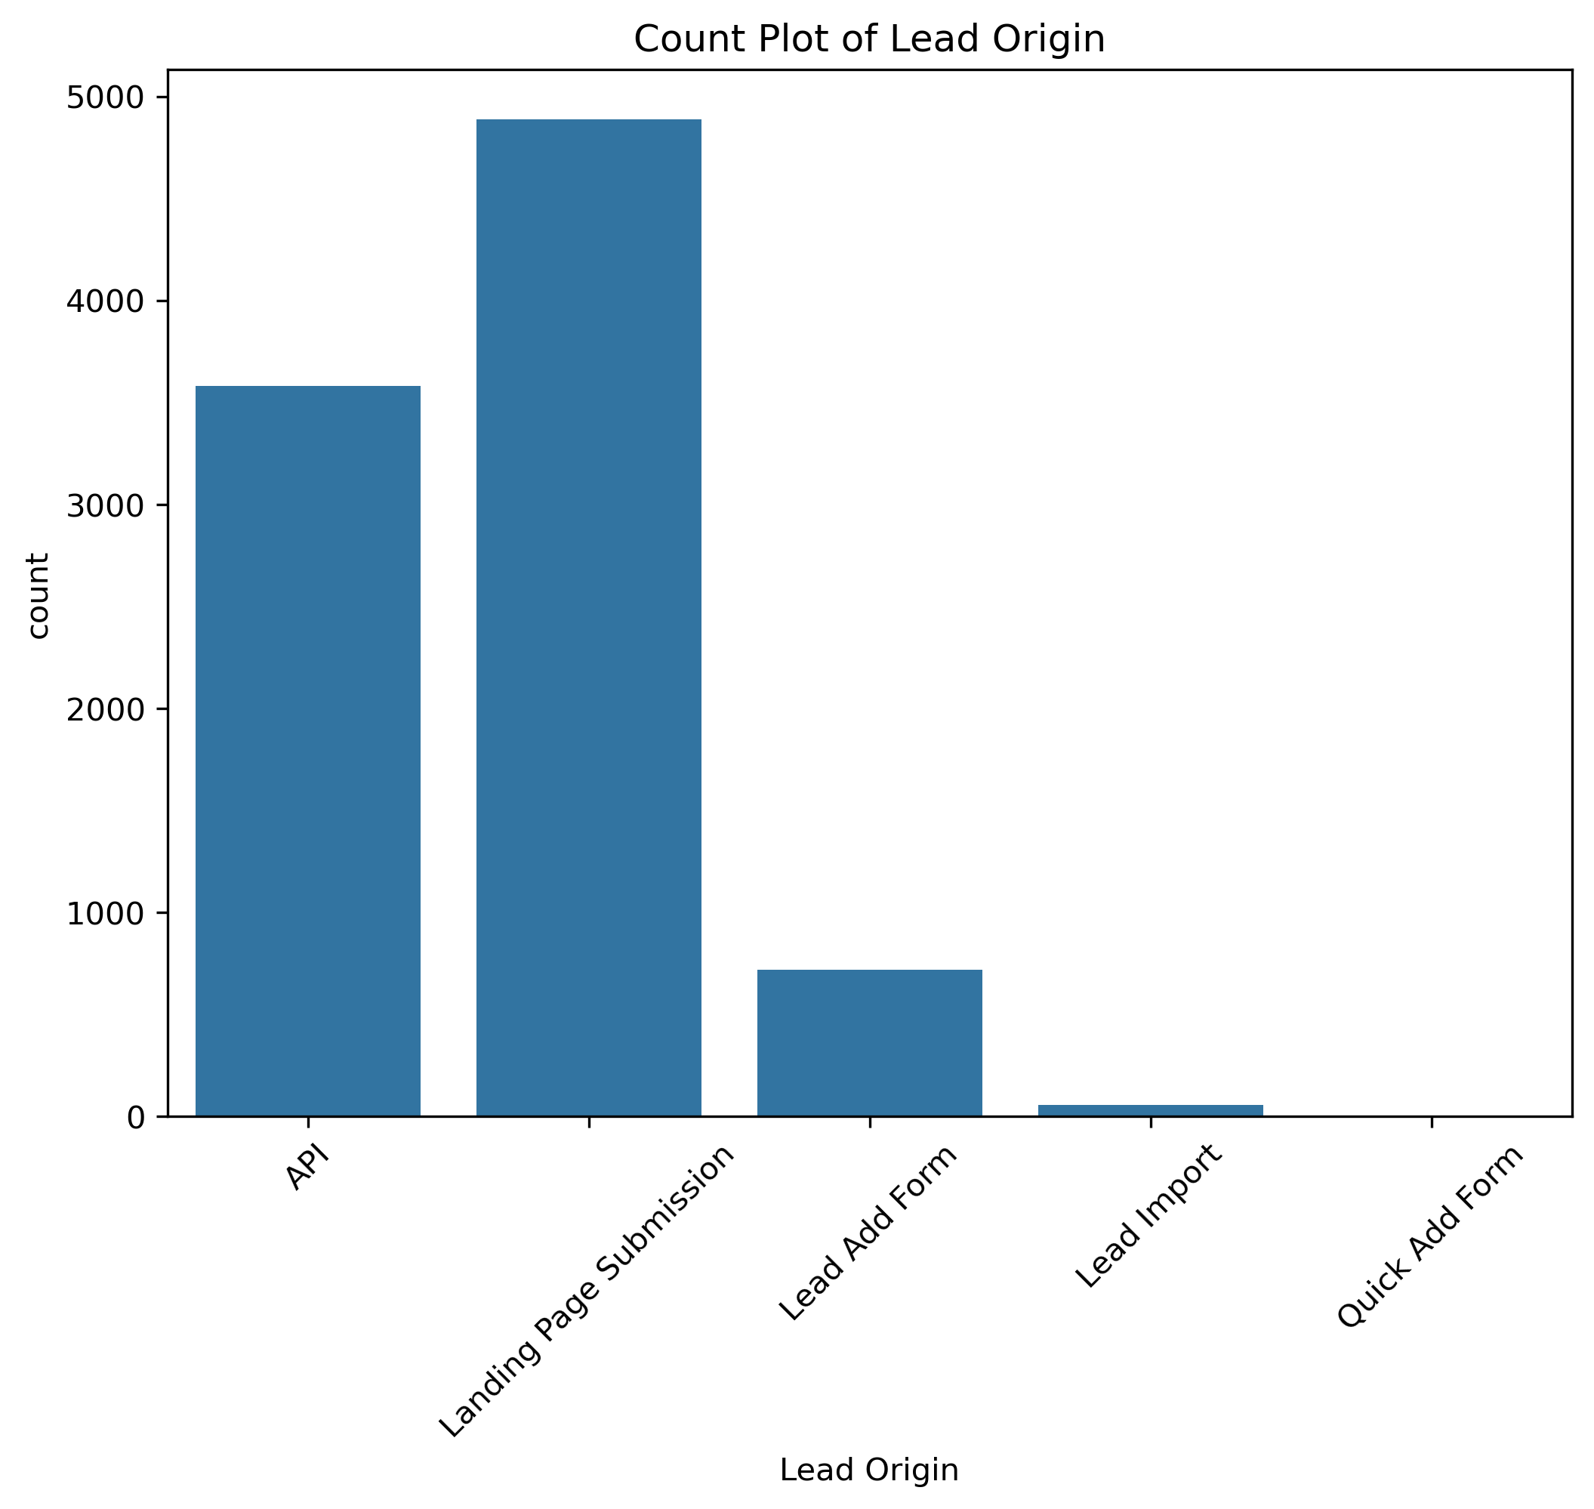
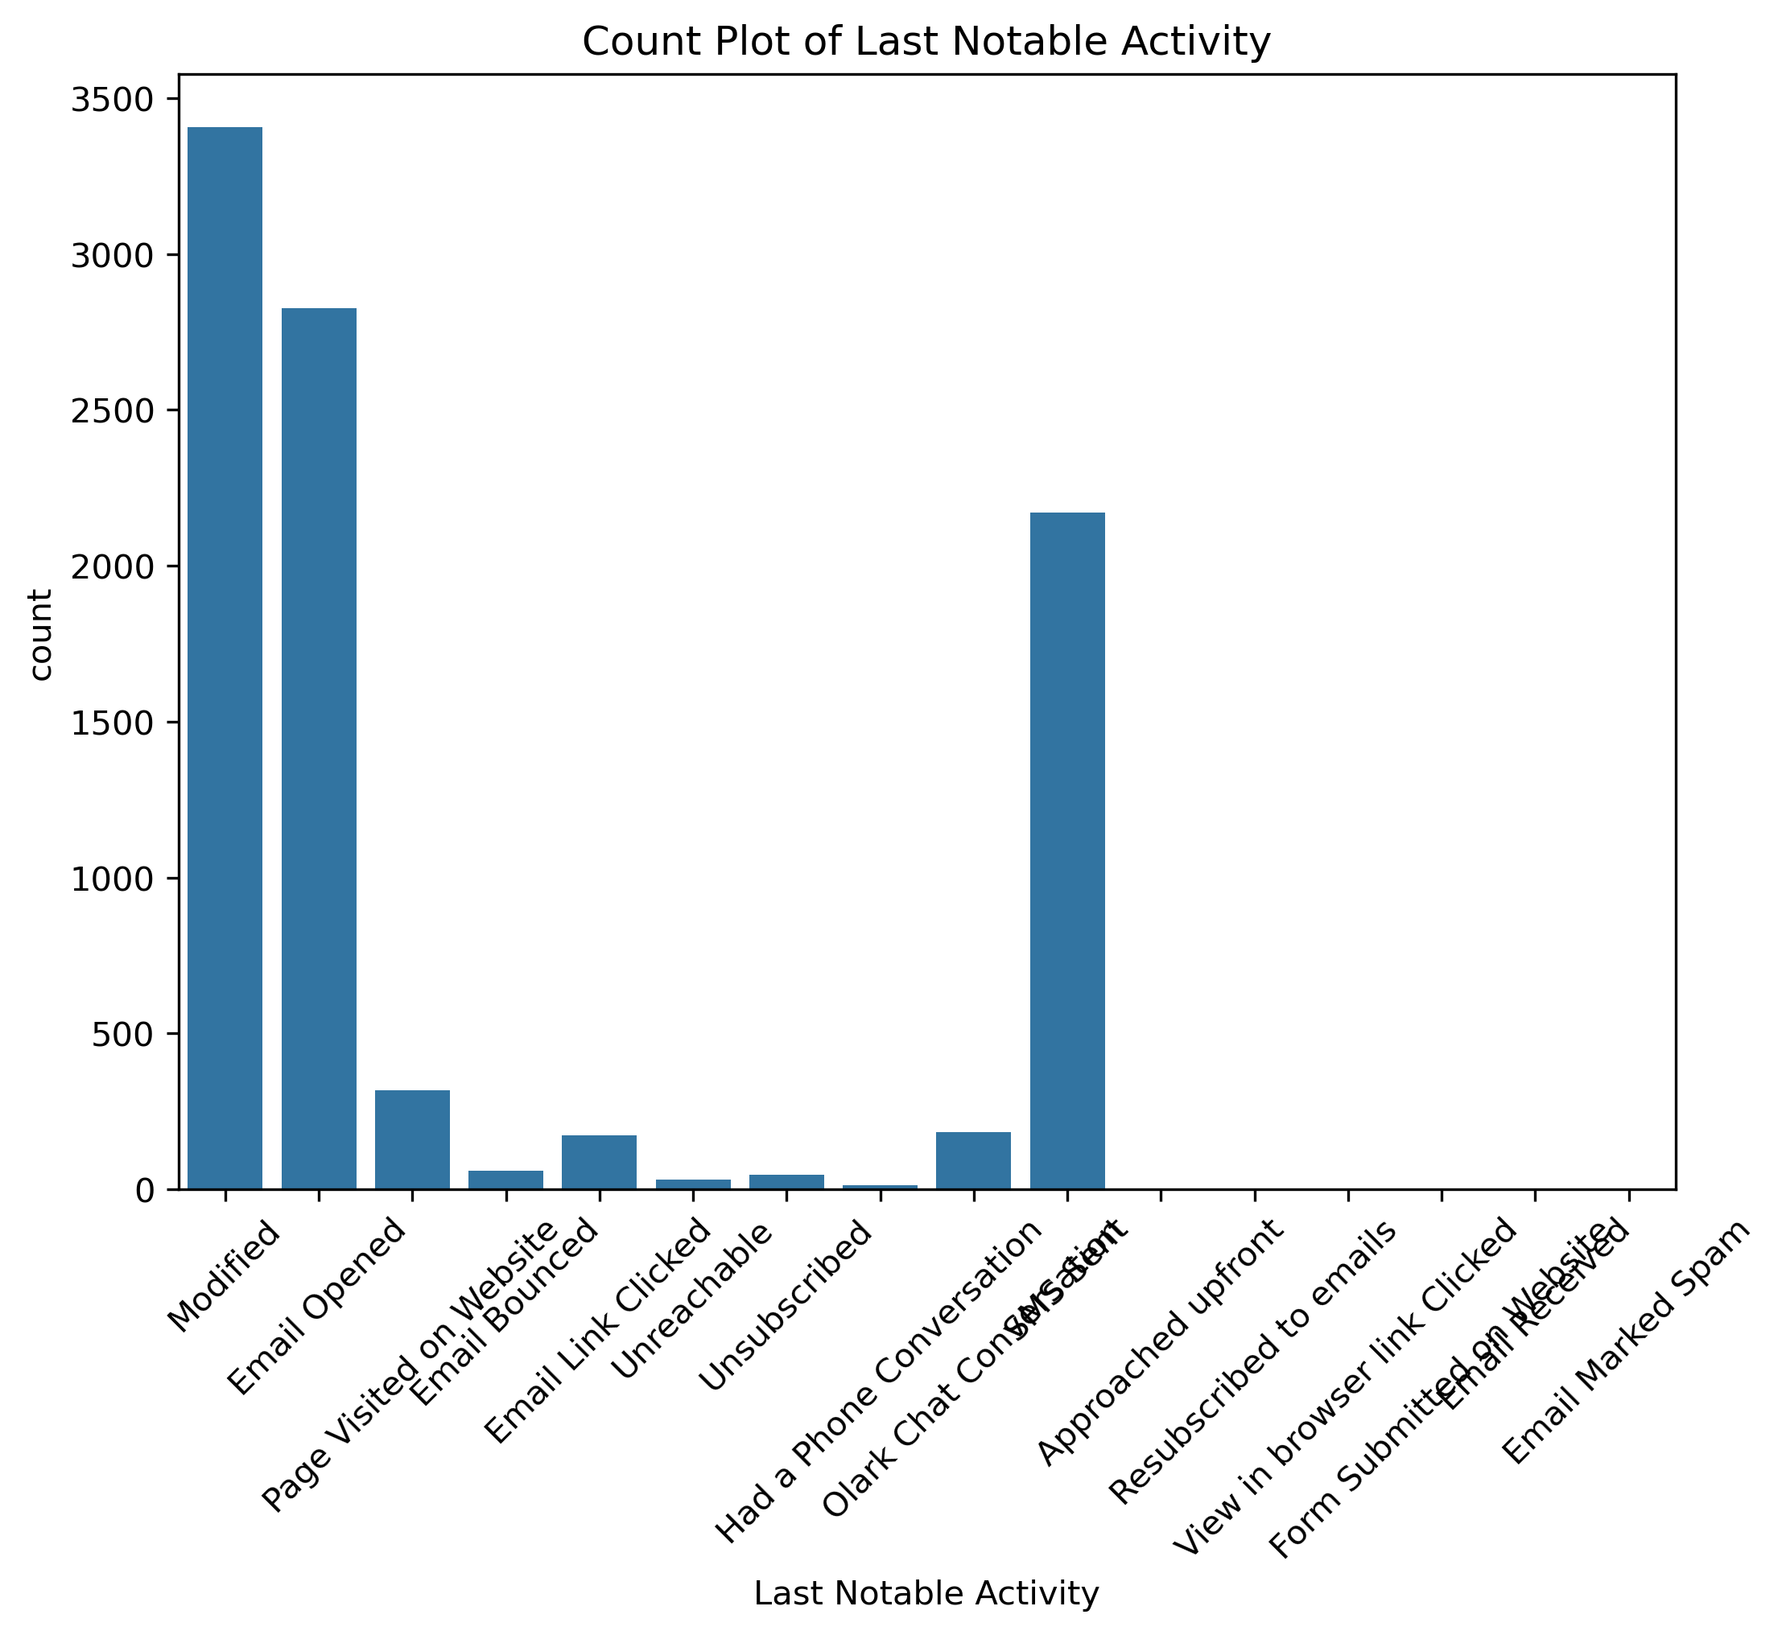
EDA - Univariate Analysis - Categorical
In lead source the leads through google & direct traffic high probability to convert
Whereas in Lead origin the greatest number of leads are landing on submission
X Education gets a lot of leads, its lead conversion rate is very poor. For example, if, say, they acquire 100 leads in a day, only about 30 of them are converted.
Upgrad Assignment

Slide 7
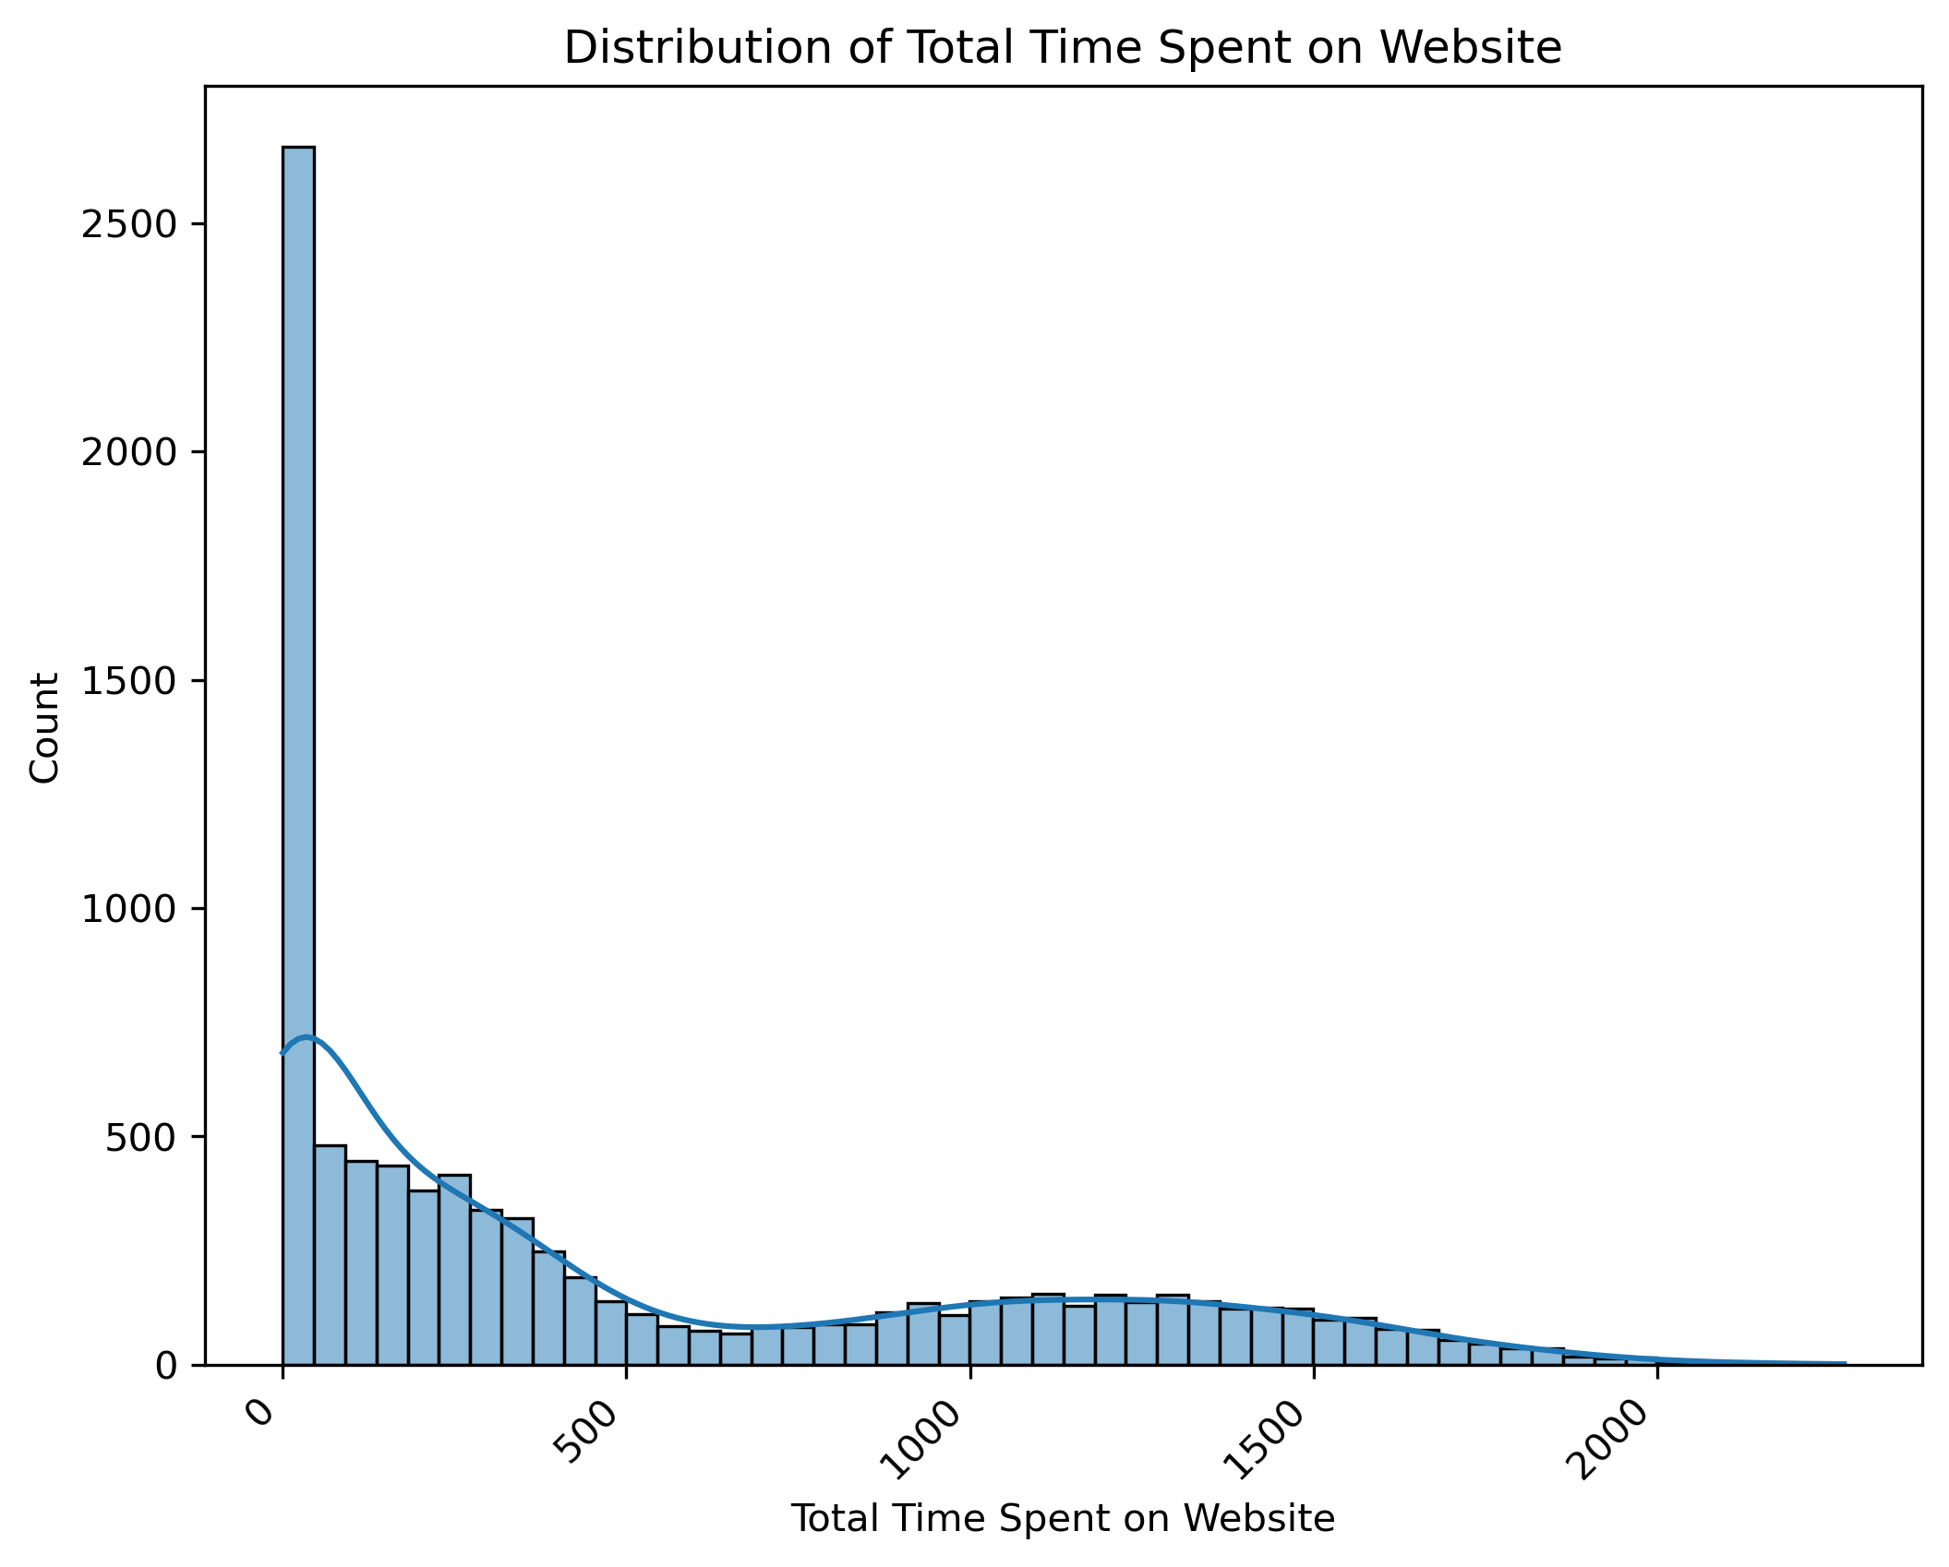
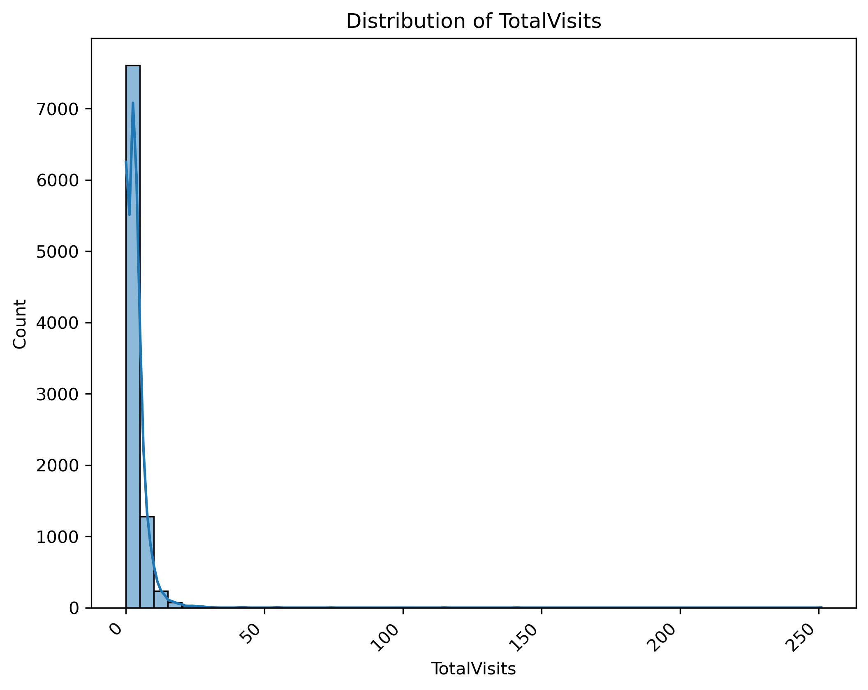
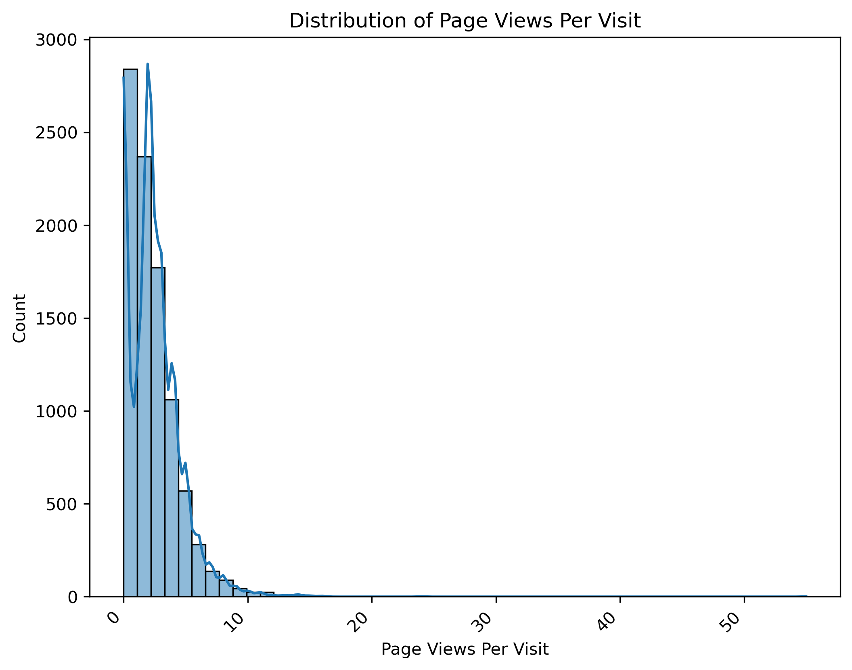
EDA - Univariate Analysis - Numerical
'Total Time Spent on Website','TotalVisits','Page Views Per Visit' displays a downward trend.
All the three variables looks insightful as the trend forms a pattern over count.
Numeric variables are highly useful to understand the distribution of the count.
Upgrad Assignment

Slide 8
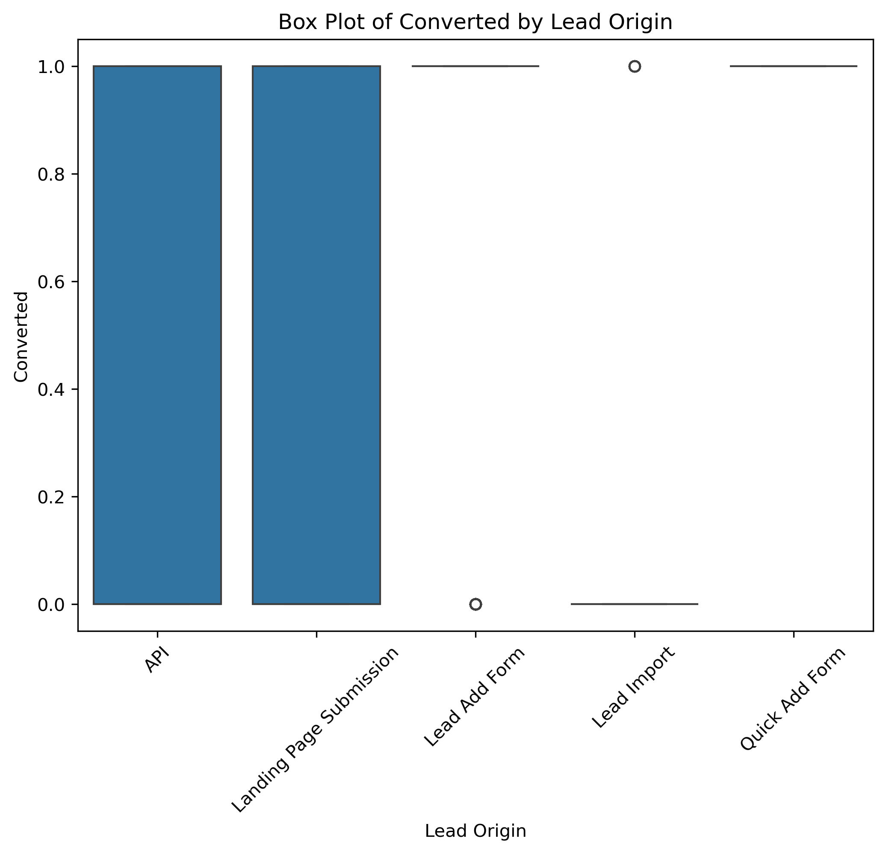
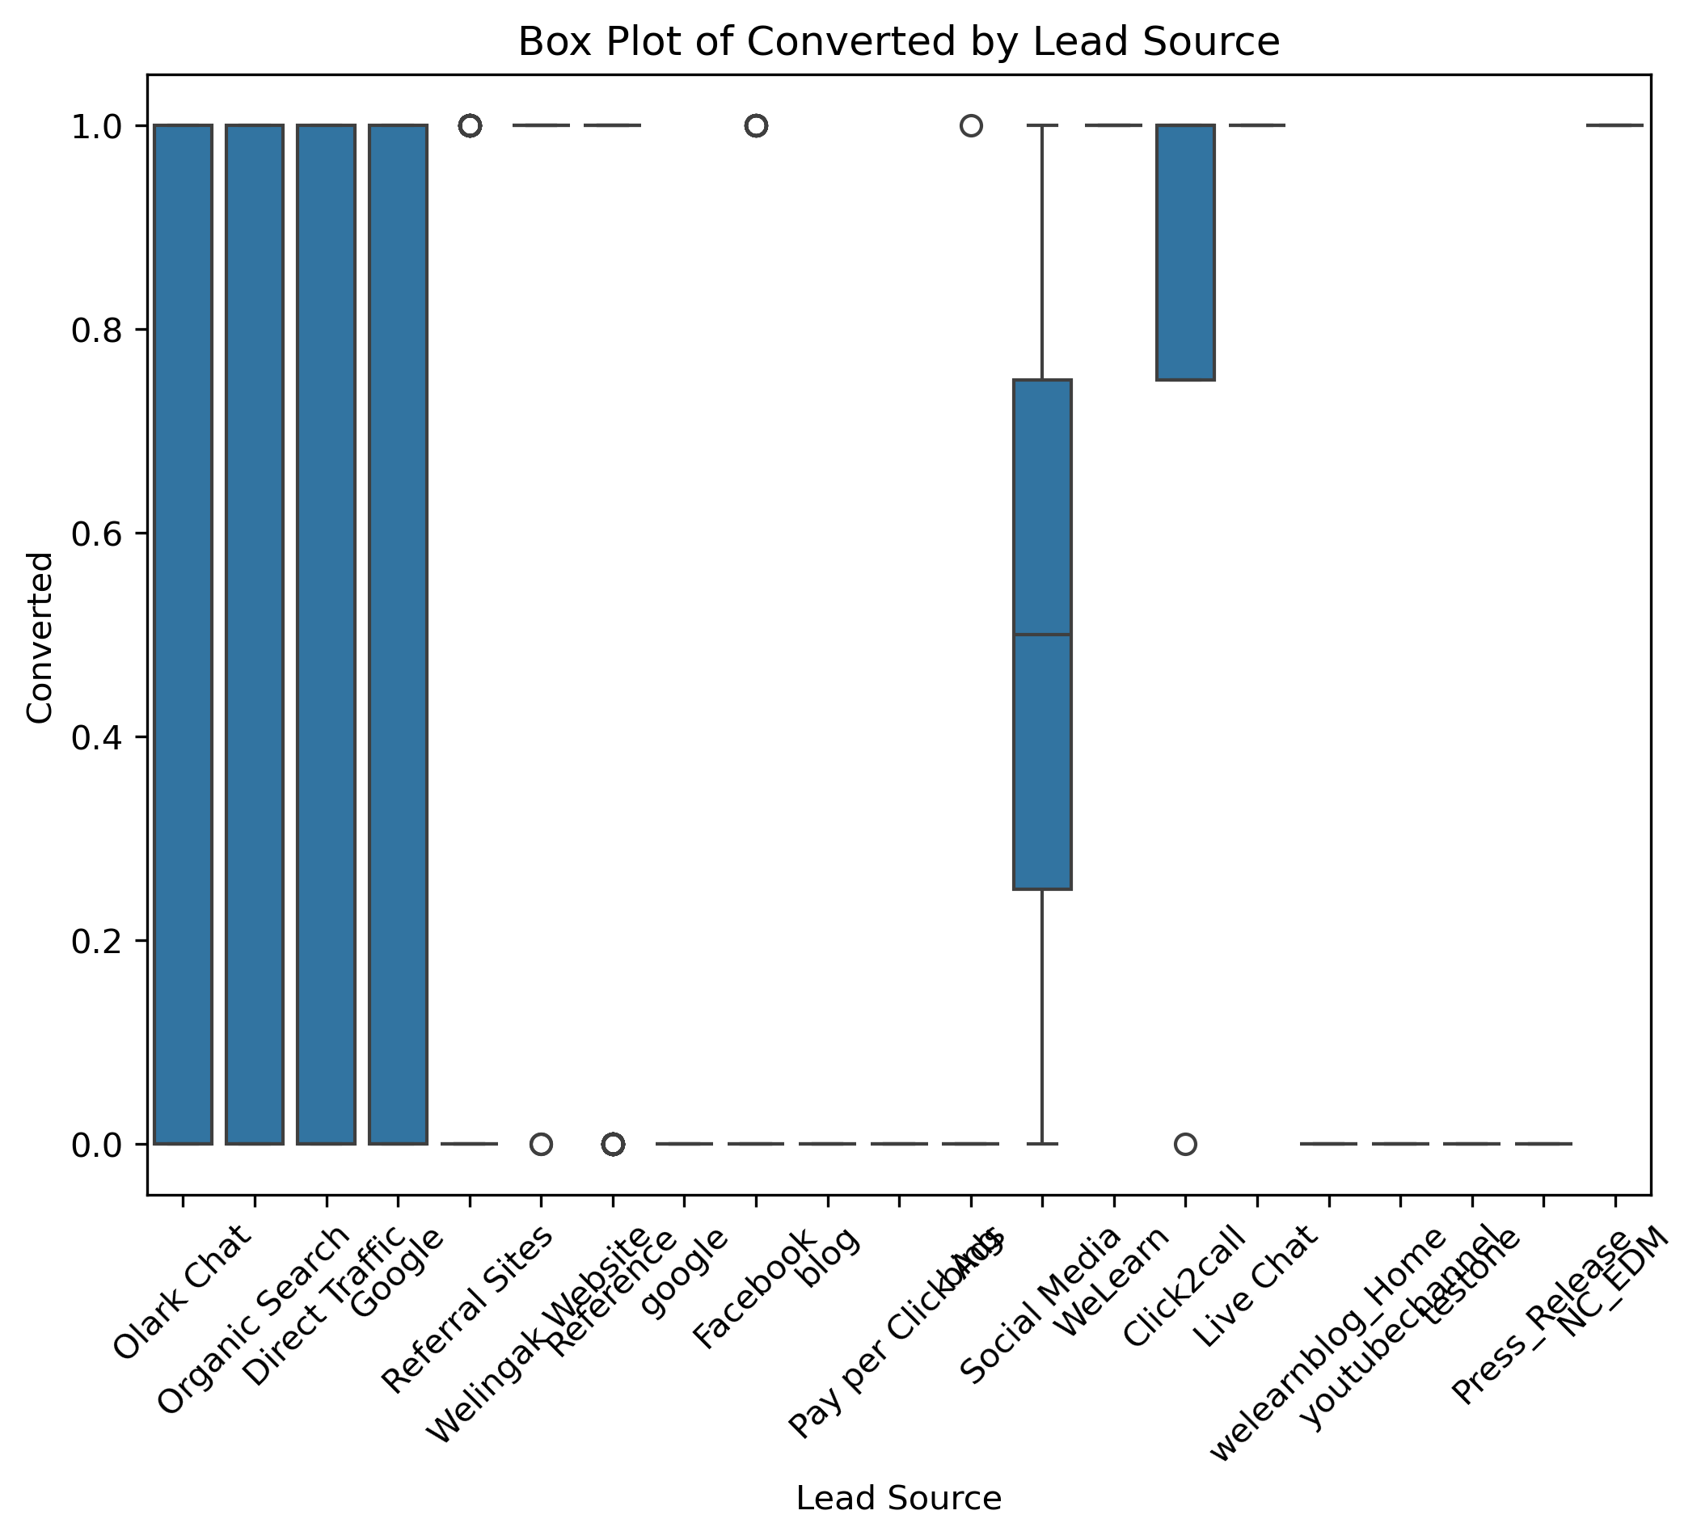
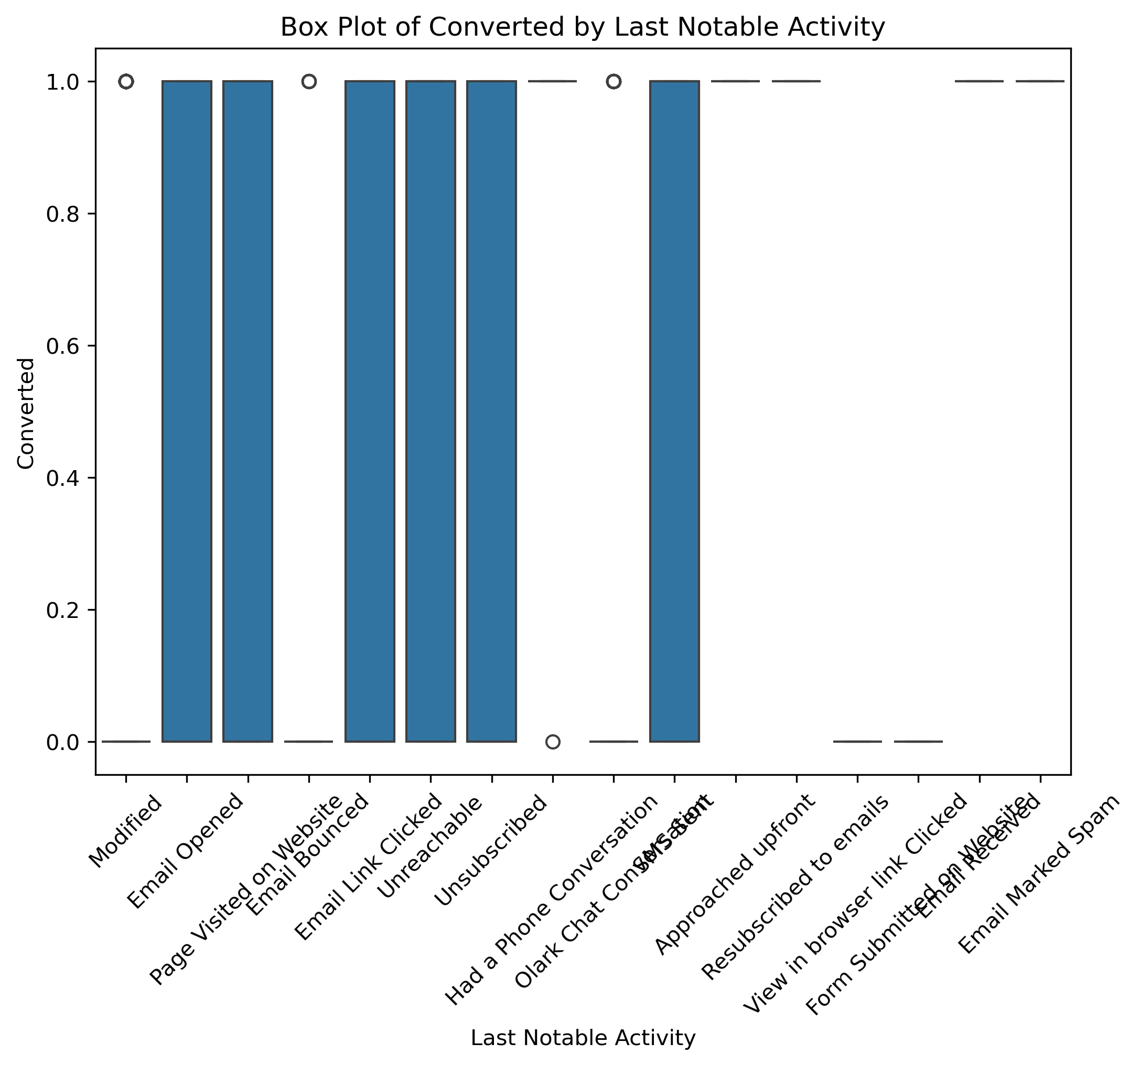
Bivariate Analysis – Target(‘Converted’)
'Lead Origin’ has insights on distribution based on API and 'Landing page submission’
'Lead Source' shows promising insights about conversion and major sources like Olark, google, we chat etc. which needs to be explored.
'Last Notable activity' shows definitive information about lead conversion.
Upgrad Assignment

Slide 9
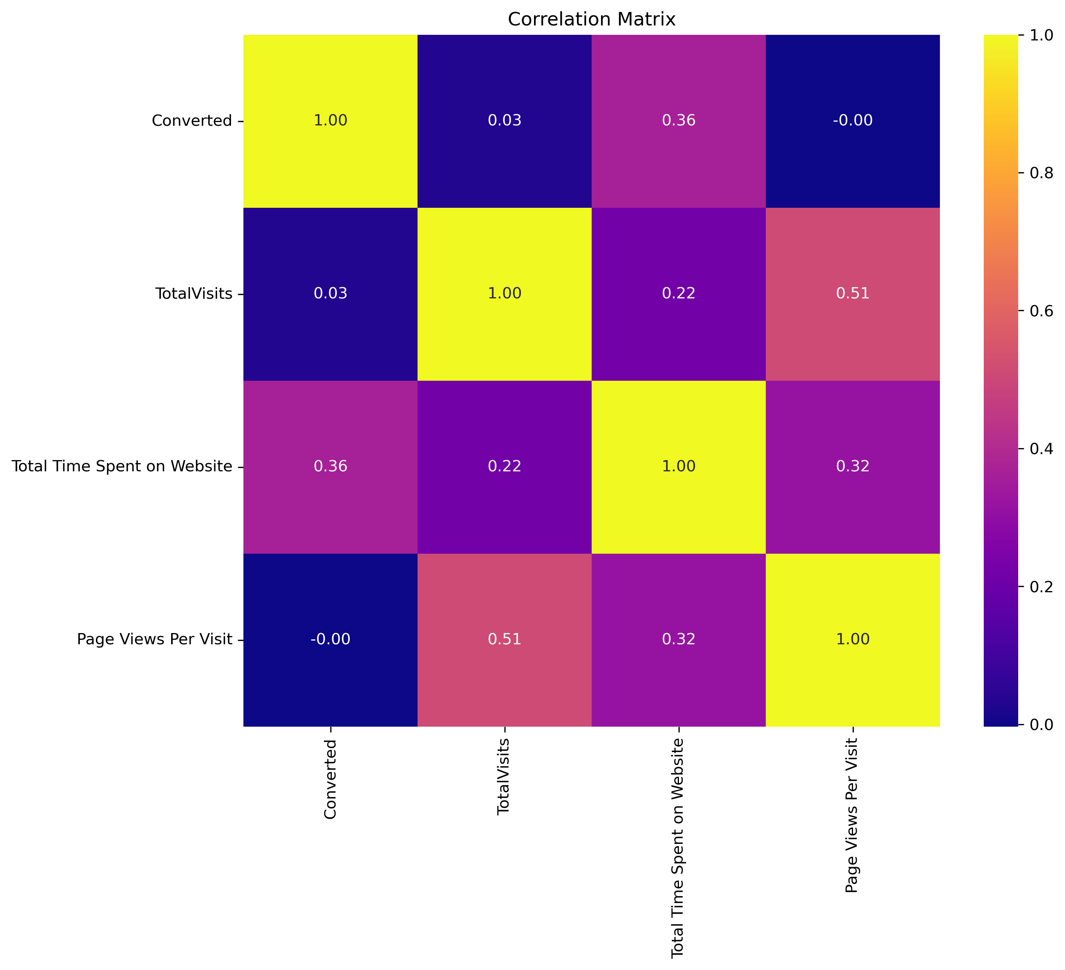
Correlations
Correlation between Total Visits and Page view visit is observed at 0.51 which is comparatively lower.
No other major correlation observed.
Upgrad Assignment

Slide 10
Model Building
Splitting the Data into Training and Testing Sets
The first basic step for regression is performing a train-test split, we have chosen 70:30 ratio.
Use RFE for Feature Selection
Running RFE with 15 variables as output
Building Model by removing the variable whose p- value is greater than 0.05 and vif value is greater than 5
Predictions on test data set
Overall accuracy 81%
Upgrad Assignment

Slide 11
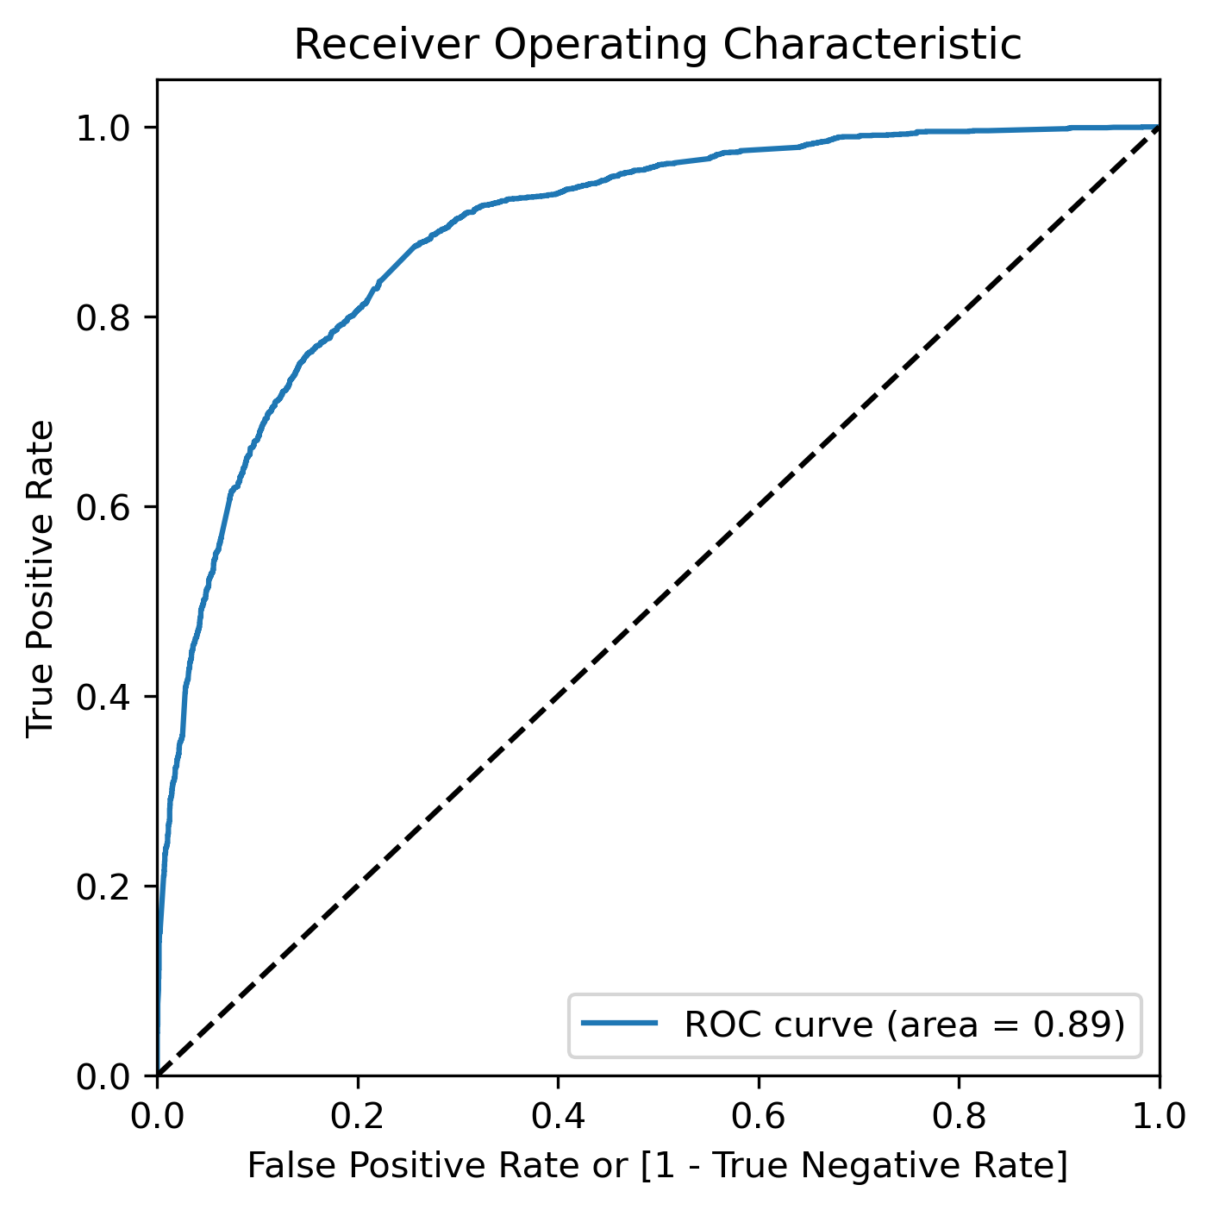
Model Evaluation –ROC curve
A Receiver Operating Characteristic (ROC) curve is a graph that shows the performance of a model across all thresholds by plotting the true positive rate (TPR) against the false positive rate (FPR). The closer the curve is to the upper left corner, the better the model's overall accuracy
ROC area under the curve values are in acceptable range(0.89)
Upgrad Assignment

Slide 12
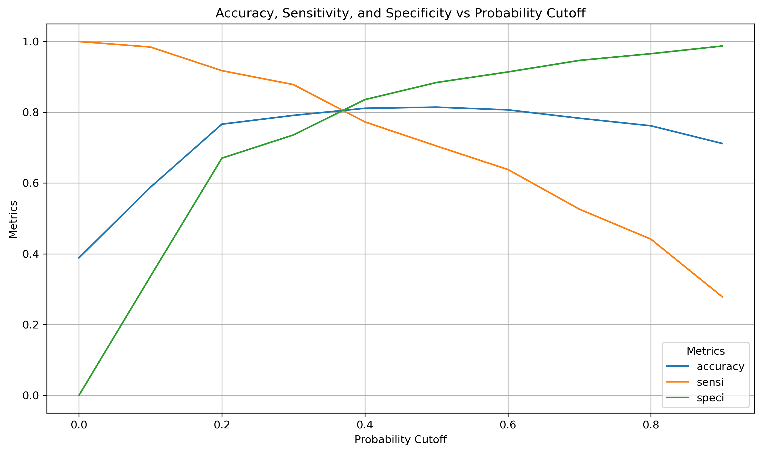
Model Evaluation –ROC curve
To find optimum cutoff for the Probability conversion rate , we have used a function to determine the best possible value as '0.38'
Upgrad Assignment

Slide 13
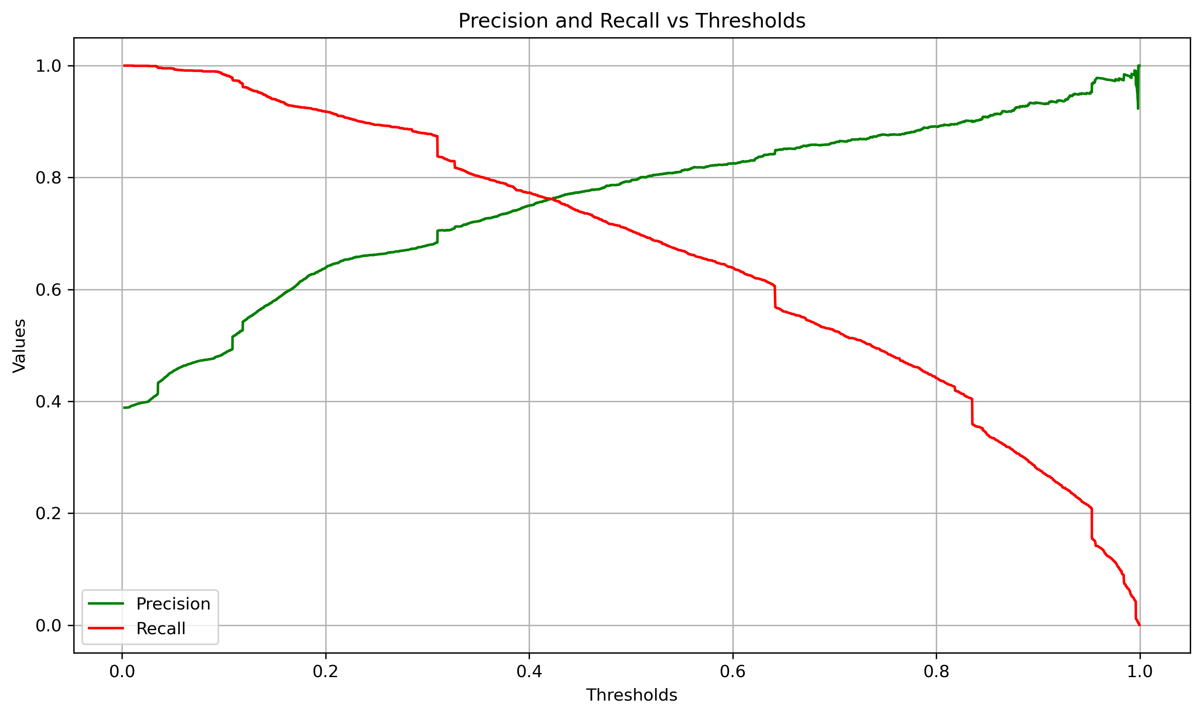
Model Evaluation-Precision & Recall tradeoff
To find optimum cutoff for the Probability conversion rate , we have used a function to determine the best possible value as ‘0.42'
Upgrad Assignment

Slide 14
Observation
FINAL SELECTED FEATURES
Total visits.
The total time spend on Website.
When the lead origin was:
Lead Add form
Landing Page submission
When the last notable activity was:
Had a phone conversation
Unreachable
When the last activity was:
SMS sent
Olark chat conversation
When the Lead source is "olark chat".
When their current occupation is as a working professional
Train Data:
Accuracy : 80%
Sensitivity :78%
Specificity : 82%
Test Data:
Accuracy : 81%
Sensitivity : 78%
Specificity : 82%
Upgrad Assignment

Slide 15
Conclusion
Below mentioned category of People should be reached for Lead conversion
Customer spending lots of time on the website. (Also to improve the metric website User interface and functionality can be made more user friendly and appealing.)
Customer Visiting the site regularly. (This metric will improve automatically if the above metric is improved).
People identified as Lead(Lead origin) from “Lead Add Form” source have more potential of conversion.
People receiving a “Phone call” as “Last Notable Activity” are higher chance of conversion. So, reaching out people with above conditions are ideal.
Customer whose occupation is “Working professional” have higher chance of conversion.
If the above factor are taken into account Lead scoring rate can be vastly improved.
Upgrad Assignment

Slide 16

Thank You!
Upgrad Assignment

